Slide 1

Employment and Social Development Canada (ESDC) Chief Data Office (CDO)
Presentation to:
Digital Academy - Premium Data and AI/ML learners
[Specialized data and AI/ML skills in the Government of Canada (GOC)]

Slide 2

Why do we need AI ?
ESDC is adapting to a changing data-driven world
Client expectations have changed
Clients expect private sector level of service, but with a much higher standard for privacy protection. We must integrate our data to support proactive client service within secure and managed environments.
ESDC has changed
Evidence-based decision making and Results & Delivery, the Service Transformation mandate, and a focus on transparency require access to data. We must know what data we have and how to use it.
Technology and analytical methods have changed
We have fallen behind in the underlying investments needed to use and extract the value of data. We need people, technology and an analytics program to tie it all together.
“I believe that government departments and organizations urgently need to turn their attention to this issue. They need to focus on collecting the right data to support their activities, on ensuring that data is well-managed and up-to-date, and on fully using this data not only to inform their core business, but also to support reporting and continuous improvement.”
2016 Spring Reports of the Auditor General of Canada, Opening Statement, May 3, 2016

Slide 3
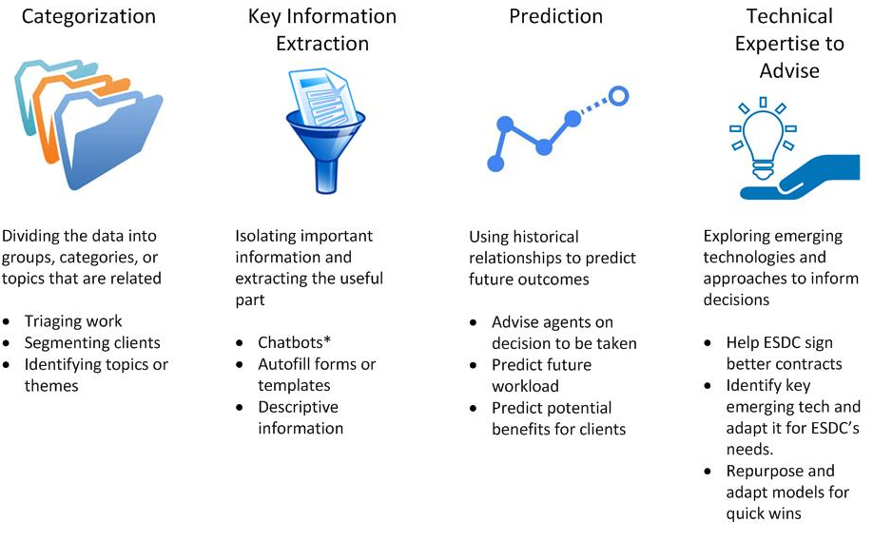
Why do we need AI? (cont.)
The need for A.I. expertise at ESDC
*Chatbot: or "bot" is an application that performs an automated task, like interacting and responding to users using natural language processing, and performing automated tasks

Slide 4
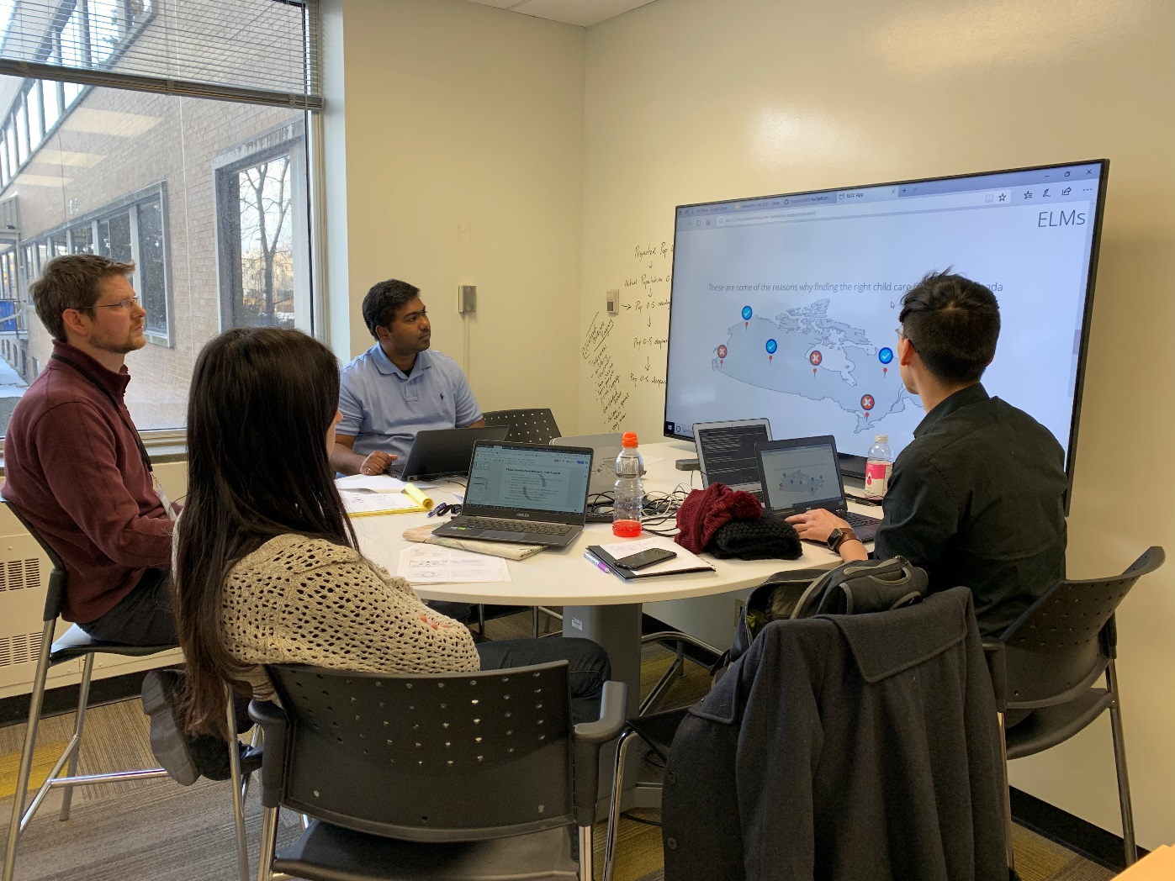
What we’re doing at ESDC…

Slide 5

ESDC’s A.I. Strategy
The need for an A.I. Strategy:
Clarify thinking around challenges and opportunities
Support GoC-wide A.I. policies
Educate and dispel myths
Help ensure responsible use of A.I.
Grounded in experience
Describes domains of A.I. investment and applications in ESDC
A.I. Policy addresses key aspects, including:
Legal, Ethics, Transparency, Accountability, Privacy, and Security

Slide 6
ESDC’s A.I. Strategy Principles
Develop a modern AI suite to transform the way ESDC delivers services to Canadians
Develop a policy for acceptable AI use in light of the risks it poses
Strengthen our internal capacity in AI development
Organize ourselves to properly steward the most important component of the current AI wave: the data
Obtain maximum public value for our investments in AI in discussions with vendors
Engage across the organization to promote AI and coordinate initiatives
Put in place the right platform for the development and deployment of AI solutions
Develop processes and controls for AI models to ensure they do what we want them to do
Design a framework for monitoring performance and evaluating success of AI solutions to prove value to Canadians

Slide 7
Ethical use of AI
What happens when jobs change?
How do machines affect our behaviour and interaction?
How can we guard against mistakes?
How do we eliminate AI bias?
Notes:
The hierarchy of labour is concerned primarily with automation. As we’ve invented ways to automate jobs, we could create room for people to assume more complex roles, moving from the physical work that dominated the pre-industrial globe to the cognitive labour that characterizes strategic and administrative work in our globalized society.
machines can trigger the reward centres in the human brain: think click-bait headlines and video games. If used right, this could evolve into an opportunity to nudge society towards more beneficial behavior.
If we rely on AI to bring us into a new world of labour, security and efficiency, we need to ensure that the machine performs as planned, and that we can explain the decisions that effect Canadians
Though artificial intelligence is capable of a speed and capacity of processing that’s far beyond that of humans, it cannot always be trusted to be fair and neutral. We shouldn’t forget that AI systems are created by humans, who can be biased and judgemental. Checks and balances need to be put in place to test for bias

Slide 8
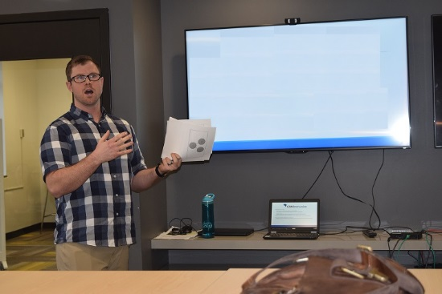
ESDC Pilot Projects

Slide 9
CDO-Partnered A.I. Pilot Projects
HR
Employee exit survey analysis (Completed)
Onboarding chatbot (Ongoing)
Application screening (Ongoing
Operations
T4 returns automation (Completed)
Workload triage (Ongoing)
Agent case notes NLP* tool (Ongoing)
Various processing pilots (Ongoing)
GIS Involuntary Separation (Completed)
Audit
Horizontal risk assessment (Phase 1 Completed)
Communications
Newsdesk automation (Ongoing)
Stakeholder monitoring tool (Not Started)
Labour program
Collective agreement information retrieval (Completed)
Legal services
Paralegal support for legal files (Ongoing)
Survey Analysis
Poverty reduction strategy (Completed)
Homelessness (Completed)
*NLP: Natural Language Processing: refers to the ability of machines to read, understand, categorize, summarize, extract information from and create information in written natural language.

Slide 10

Example #1: A.I.-enabled work item processing
Business Context
Canada Pension Plan (CPP) and Old Age Security (OAS) recipients receive annually a T4 form containing the benefits received that they will need to report on their tax return. Many T4s are returned to Service Canada due to address changes or other reasons and must be investigated.
Each year, large numbers of clients follow up with Service Canada to request a duplicate T4, which is immediately reissued. However, the reissuance is only captured in call centre notes and the resource intensive investigation of every single individual returned T4 is still performed.
Problem
Scan Call Centre notes
Machine proactively looks at call centre agent’s note in order to identify T4s already reissued and avoid duplication of work
Detect info needed
Eliminate completed work item
SINs of clients who have been reissued a T4 are provided to processing and eliminated from the queue
Machine Learning model trained to detect T4 reissuance in notes
T4
Solution
Reissue a T4 to clients who have not already been reissued one
Low-value work eliminated: 50,000 work items, or 2.5 FTEs, saved annually, while development only used 0.1 FTE
Work inventory is reduced, with faster processing for remaining clients
Once built, the models can be repurposed to answer new questions
Value

Slide 11



Example #2: A.I.-enabled media monitoring tool
Business Context
Every day, a package is produced for the ministers that provides pertinent news articles pertaining to ESDC’s mandate.
Problem
The package is produced by analysts who manually review news media starting at 3am each day. The volume to be monitored is often beyond the capacity to review every article and leaves little time for analysis.
Process articles
Machine reads and converts all articles into mathematical representation of meaning
Predict relevance
Create package
Automated briefing package created based on highest probability articles
Machine assigns a probability score to every article
Articles received
Solution
Analyst
Package produced
Reduced workload for employees
Timelier package production allows for real analysis on what the news means for the Department
More media can be searched and evaluated in a consistent fashion
Value

Slide 12
Stakeholders | Projects
Public Affairs and Stakeholder Relations Branch (PASRB) – Media Monitoring (Christine) (Project Underway) http://10.54.221.136:3010/en/ | Business Context: Everyday, thousands of articles and news stories on ESDC or its Ministers are produced. Keeping track of what is being said about the department, its programs or its Ministers with manual techniques is becoming more and more difficult as the speed at which news are produced. Current Situation: The Government of Canada (GoC), through Public Safety Canada, purchases a list of articles pertaining to all federal departments. Those lists are then shared with departments for further analysis. ESDC employees currently come in to work at 3 A.M. in order to open and read between 800 and 1000 articles. Of those, about 100 are evaluated and summarized for ESDC’s higher management. Manual monitoring of a sample of all news related to the department is resource intensive and time consuming. Solution Proposed: The CDO is working on a tool that will rate not only a sample, but all the articles provided by Public Safety Canada everyday. It will rate articles according to their content, the mention of an ESDC program or it ESDC’s Ministers are mentioned. Once the monitoring part of the model is up and running, an automatic summarizer will be implemented.

Slide 13
Example #3: A.I. vendor negotiations with Audit
Business Context
External Artificial Intelligence (A.I.) tools are increasingly being considered by various branches in their attempt to leverage their data assets. However, expertise in A.I. is still sparse in the department, making negotiations with external vendors challenging.
Problem
Audit contacted a private vendor to acquire a machine learning categorization tool. The private vendor would have required the department to pay development costs up front, acquire a subscription to use the model and ESDC would own no intellectual property (IP). Upon delivery, the solution required additional work to reach its full potential.
Technical input
CDO provided input in the negotiation with the vendor and offered Audit an alternative internally-build solution
Stronger bargaining position
Model improvements
CDO took the delivered model, refined it and added a number of significant functionalities to create the final product.
Audit was able to negotiate for the full model IP at a lower cost
Solution
Audit contracted for a better product at the same costs and ESDC kept the IP
External expertise is leveraged to hit tight timelines
The CDO leveraged the externally developed model to improve the overall product
The final product drew interest from many other federal organizations and ESDC will be able to share as it owns the IP.
Value

Slide 14
Stakeholders | Projects
Internal Audit Service Branch (IASB) (Project Completed) | Business Context: External Artificial Intelligence (AI) tools are increasingly being considered by various branches in their attempt to leverage their data assets. However, the knowledge of the different techniques in the department is sparse so leveraging external vendors is a common option explored. Current Situation: Audit contacted a private vendor to acquire a machine learning categorization tool. The private vendor would have required the department to pay development costs up front, acquire a subscription to use the model and ESDC would own no intellectual property (IP). Upon delivery, the solution required additional work to reach its full potential. Solution Provided: CDO provided input in the negotiation with the vendor and offered Audit an alternative internally-build solution. Audit was able to negotiate for the full model IP with no ongoing subscriptions fees. The discussion between the CDO and Audit allowed Audit to better define their requirements. CDO took the delivered model, refined it and added a number of significant functionalities to create the final product. The final product drew interest from many other federal organizations and ESDC will be able to share it as it owns the IP.

Slide 15

Any Questions ?
In summary, to be successful in AI we need to:
Hold ourselves to the highest standard
Start small and build..but start
Think ethics up front
AI for tasks to help our staff do their jobs

